Slide 1

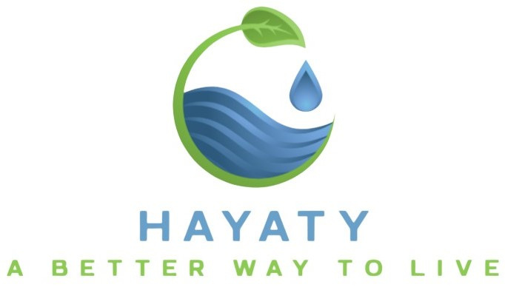



1

Slide 2



Introduction
Today, we are going to address one of the most pressing challenges facing our world: water scarcity. As populations grow and the demand for water increases, many regions are experiencing severe shortages, with significant impacts on agriculture, industry, and human well-being. Water scarcity is not just a problem for a few countries—it's a global crisis affecting millions of people and economies.
2

Slide 3

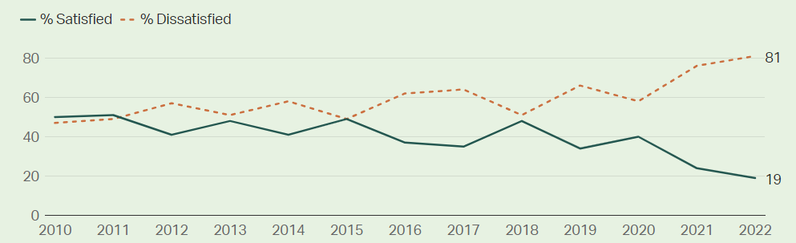
Tunisia and water crisis
Tunisians are far less satisfied with water quality than any other population in the Middle East and North Africa (MENA) region, where there is widespread water insecurity and dissatisfaction runs high. No other country in the MENA region -- or even the world -- comes close to Tunisia for water dissatisfaction.
3

Slide 4
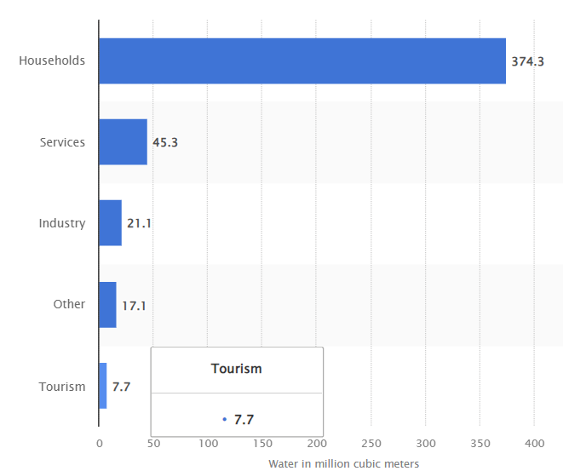
Tunisia and water crisis
Households accounted for the vast majority of the water consumed in Tunisia in 2020. That year, households in the country consumed around 374 million cubic meters of water. Services and industries followed at approximately 45 million and 21 million cubic meters, respectively.
4

Slide 5


Solution
Since households are the largest consumers of water, our solution aims to reduce individual water usage while ensuring that citizens still receive the necessary amount of water throughout the day. This approach will help eliminate the issue of water cuts, allowing for more efficient water distribution and better management of resources.
5

Slide 6

how does it work ?
1
The user puts his location as input
2
The system allocates the appropriate amount of water for use
3
If the user exceeds this limit, their water supply will be temporarily cut off.
6

Slide 7


Methodology
The AI model will train on a dataset containing the following features:
Location
Population
Water availability in that location
The person’s use of water in that region
Depending on the location input provided by the user, the system determines that location‘s population and water availablility, then predicts the person’s appropriate daily use of water
7

Slide 8

Result
Every individual will know how to better manage his water use.
Citizens will no longer experience disruptions in their water supply.
Customers will also benefit from reduced water costs, as the system helps them avoid excessive water usage. By encouraging more efficient consumption, users will save money while contributing to better resource management and sustainability.
8

Slide 9
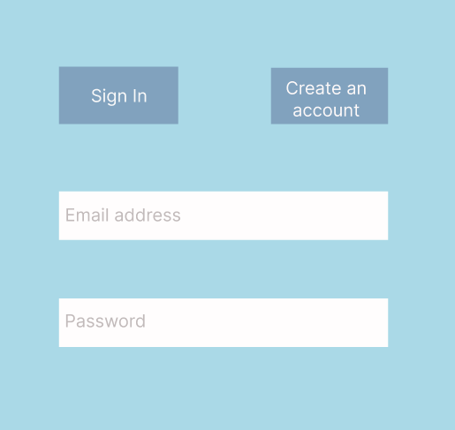
Applicatin Interface
9

Slide 10
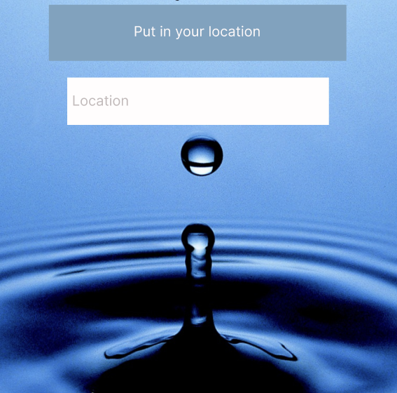
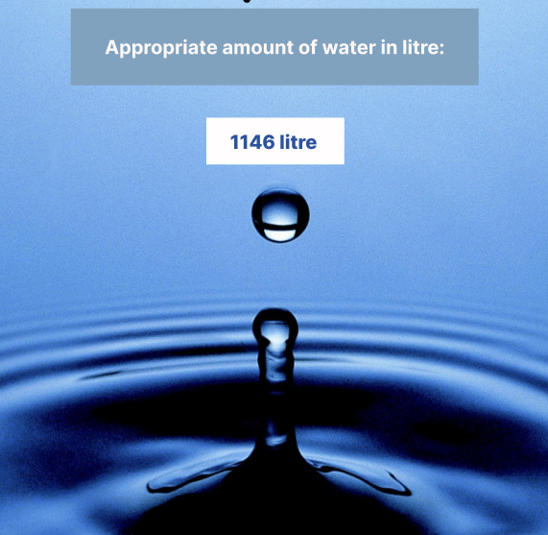
Applicatin Interface
1
10

Slide 11

Applicatin Interface
The primary source of profits for HAYATY will come from the monthly subscription fees paid by users. These subscription fees will serve as a consistent and sustainable revenue stream, ensuring that the business can continue to grow and develop over time while offering valuable services to its customers.
11

Slide 12

Conclusion
In conclusion, addressing water scarcity is critical for ensuring a sustainable future, especially in regions like Tunisia where water resources are limited. Through responsible water management, we can reduce excessive water consumption while maintaining reliable access for all citizens. By implementing this system that promotes efficient use, we can not only preserve this precious resource but also prevent the recurring issue of water cuts.
Together, we can create a more resilient and water-secure future.
12

Slide 13
Thank
you
13

